Slide 1
Sampling and measurement of Air Quality

Slide 2
Measurements of air quality
Measurements of Emissions - also called source sampling - when a particular emission source is measured, generally by on the spot tests
– Meteorological Measurement - Measures meteorological factors that show how pollutants are transferred from source to recipient
– Ambient Air Quality - Measures the quality of all the air in a particular place. Almost all the evidence of health effects is based on these measurements
Industrial Hygiene sampling - for testing the air quality inside of factories and places of work
Residential Indoor sampling - to evaluate the quality of air in living spaces

Slide 3
Air Sampling Techniques
Most air pollution monitoring equipment performs the act of sampling and analysis in one action = real time measurement
older equipment = intermittent sampling (time lag between when the sample was obtained and when data was available)
Almost all gaseous pollutants are monitored by real time analysis - Particulate pollutants are still mostly monitored by intermittent sampling, even though real time methods are available

Slide 4
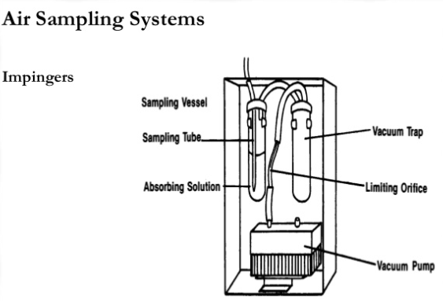
Air Sampling Systems
Require gases or particles to be drawn to the surface of a collecting medium or a sensor
sampling trains, which may include a vacuum pump, vacuum trap, a flow regulator and a collecting device or sensing unit
Sampling trains for gases may also utilize filters to present particles from entering the collection unit

Slide 5
Air Sampling Procedures
conducted by static, grab, intermittent or continuous procedures
first air monitoring used static sampling - simple and cheap – requires days for data e.g. deposit gauge
Grab sampling not commonly used to monitor ambient air quality – uses bladders of syringes
Meteorological Monitoring• changing weather conditions can produce dramatic changes in air quality and ambient pollution levels
Factors such as: – wind dispersion rates (velocity and direction) – temperature inversions – photochemical reactions, and – rain

Slide 6
Reference Methods
US EPA Methods
first generation devices - low cost unpowered devices - require long time to accumulate data e.g. deposit gauge
second generation devices - powered and require small amounts of time to produce data e.g. high volume sampler
third generation devices - produce instant (continuous data) e.g. nephelometer, gravimetric microbalance, remote UV-visible detectors and remote infra red sensors

Slide 7
Particulates – Hi Vol Sampler
most commonly used particle sampling method
analysis is gravimetric - filter is weighed before and after the analysis on an analytical balance, and difference is particulates collected
A standard high-volume sampler collects particles in the size range from 0.1 - 100 µm
airflow is measured by a small flow meter (calibrated in m3 air/minute)
particulate concentration measured is referred to as the Total Suspended Particles (TSP), = combination of Settleable particles and suspended particles
expressed as g/m3 for a 24hour period – normally as part of 6 day cycle

Slide 8
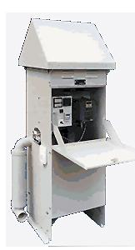

Slide 9
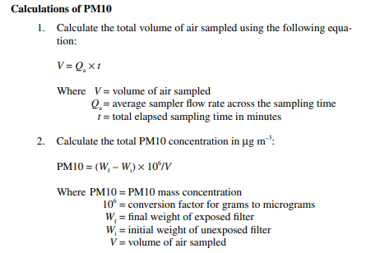
Calculate the PM10 concentration of a particular place if the High vol. sampler runs for 8 hrs with an average flow rate of 16.7 L/min, initial weight of filter paper is 4.23 gm and final weight is 6.32 gm.

Slide 10
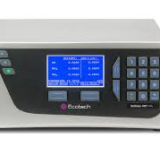
Oxides of Nitrogen: Chemiluminescence
Nitrogen dioxide is commonly measured using automatic analysers that run 24 hours a day. The main measuring method is to use a chemiluminescence continuous analyser (chemiluminescence means the emission of light as a result of a chemical reaction).
Air is drawn into the analyser where nitrogen monoxide (NO) is made to react with ozone, to give nitrogen dioxide in a reaction that generates light:
Nitrogen monoxide + ozone » nitrogen dioxide + oxygen + light emission.
This method doesn’t actually measure nitrogen dioxide but calculates the airborne levels of nitrogen monoxide and total oxides of nitrogen (NOx), and then subtracts one reading from the other. The final results are expressed in parts per billion (ppb) or micrograms per cubic metre of air, this is written as µg m-3.

Slide 11
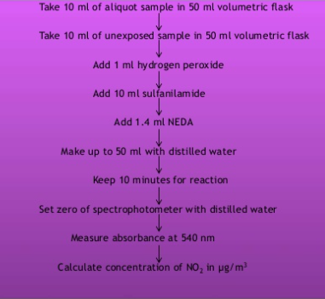
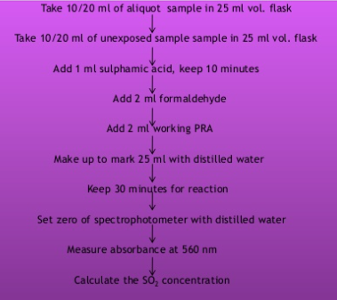
Spectrophotometric method

Slide 12
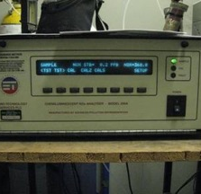
Sulphur dioxide: UV fluorescens
Sulphur dioxide is usually measured automatically, by a continuous analyser that uses ultra-violet fluorescence. The concentration of sulphur dioxide is calculated by measuring the fluorescent radiation energy produced when the sulphur dioxide molecules are bombarded by UV radiation inside the analyser.
This then provides a concentration in air, usually expressed in parts per billion (ppb) or micrograms per cubic metre (µg m-3).

Slide 13
